Slide 1
English Placement (AWPE)
Investigating the Relationship between Trustworthy AWPE Scores and Aligned English Placement
Joshua Lim, Jiping (Leo) Li, Eric Jiang, Jade Gregory, Ruibin Lyu, Katie Munteanu

Slide 2
Table of contents
01
02
03
04
Introduction
Methods
Results
Conclusion

Slide 3
Introduction
Objective: Analyze alignment between self-placement & true placement in AWPE
Dataset: UCLA student entries with AWPE< self-placement, GPA
Results:
35% of students’ AWPE scores within [41, 48]
61% in interval correctly self-placed
Conclusion:
Strong correlation between [41, 48] AWPE scores & reliable self-placement
Limitations: medium proportion of aligned scores, missing values
Future Directions: inclusion of more factors, larger sample size for robustness

Slide 4
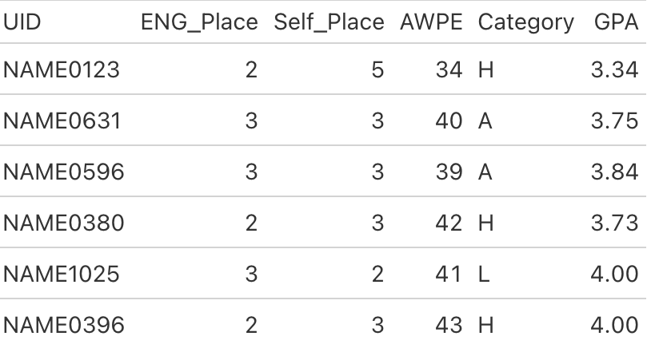
Methods: Data Cleaning
Filtered out data without placement scores or self-reported scores
Fixed the “H/L/A” column to appropriate reflect if the self-reported score was high, low, or aligned respectively
For our GPA analyses, imputed missing or zero GPAs using classification and regression trees using the mice package

Slide 5
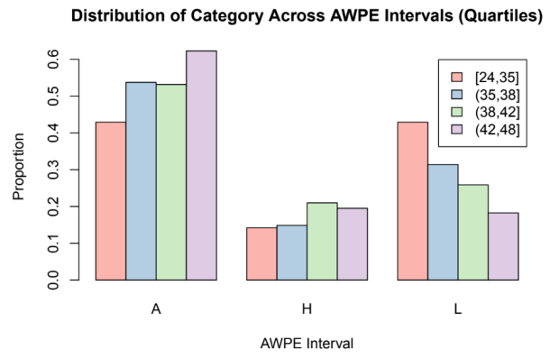
Methods: Extracting the Interval
First graphed four possible intervals
Gave us an idea that high scores had the greatest proportion of aligned placements
Ran an approximately exhaustive algorithm (brute force)
Overview of algorithm:
Start with the minimum score, construct first interval with that as lower bound and upper bound as minimum score + 1
Create all possible intervals for that lower bound by increasing upper bound by 1, compute correlation with aligned scores
Iterate through all lower bounds by 1
Take the interval with the maximum score.

Slide 6
The Interval:
AWPE Scores in [41,48]

Slide 7
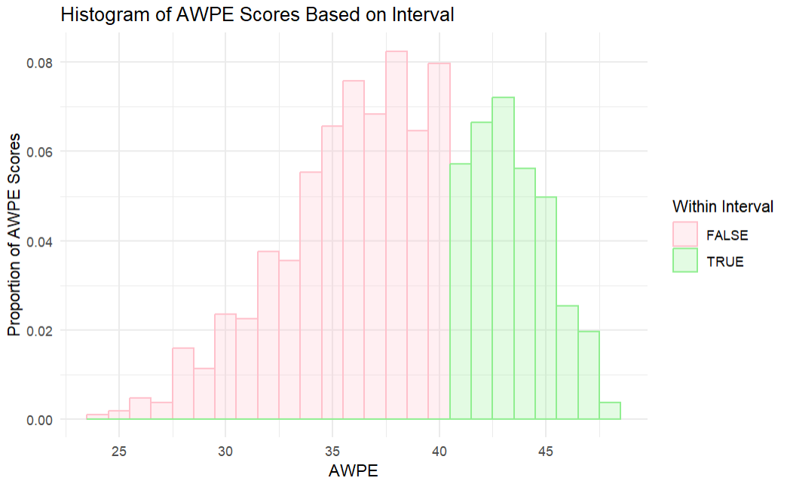
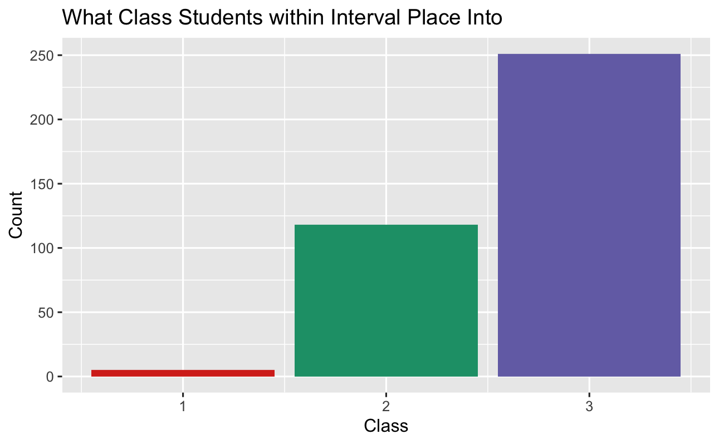
Results: Description of Interval
The distribution of AWPE scores appears to centered around 38.
The interval includes the maximum AWPE score.
Majority of students with AWPE scores in the interval placed themselves in class 3, followed by class 2.

Slide 8
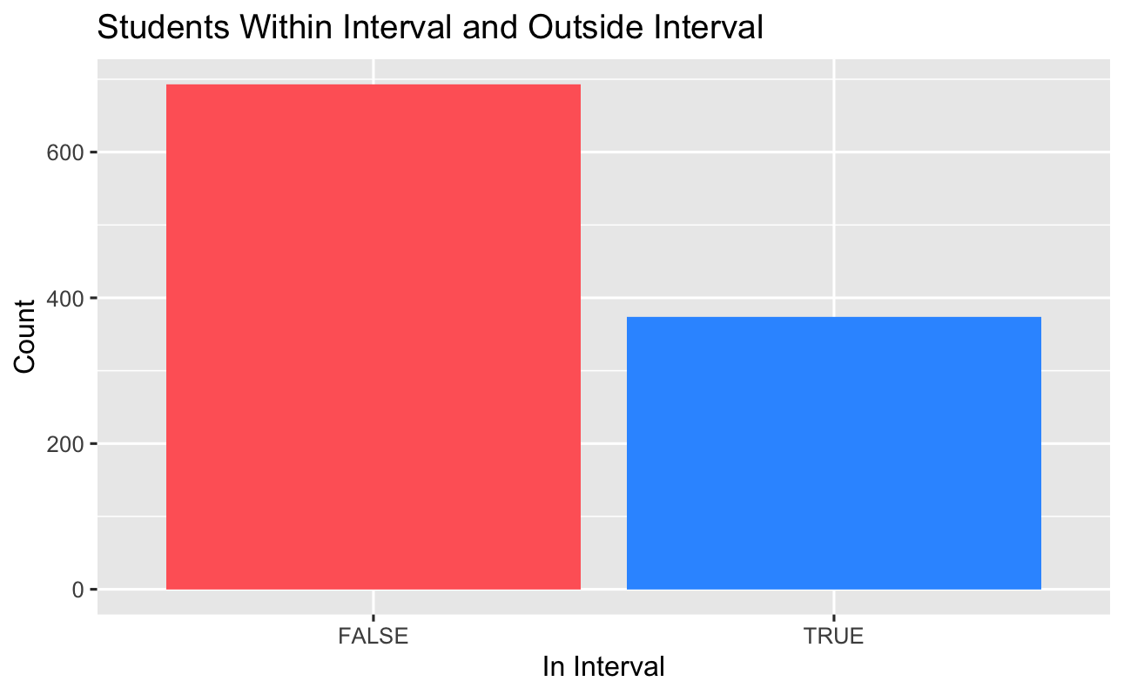
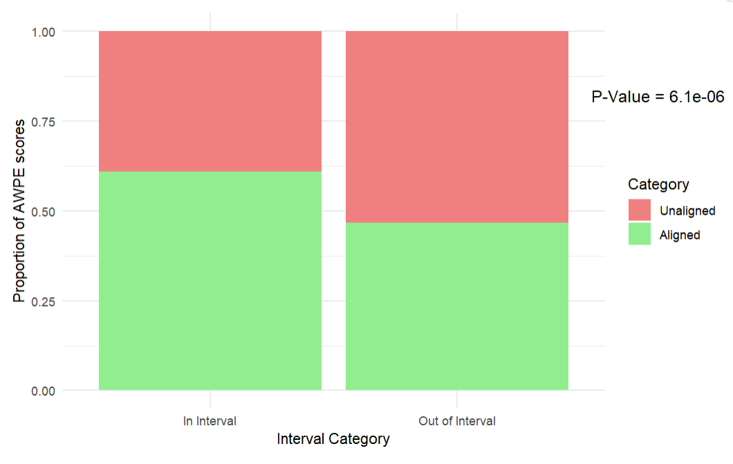

Results: Analysis of Interval
374 students inside interval, and 693 students outside.
Higher Proportion of aligned self-placement with scores in interval than out of interval.
This difference was confirmed using prop.test() with a p-value < .05
60% of aligned self-placements have AWPE scores in interval.

Slide 9
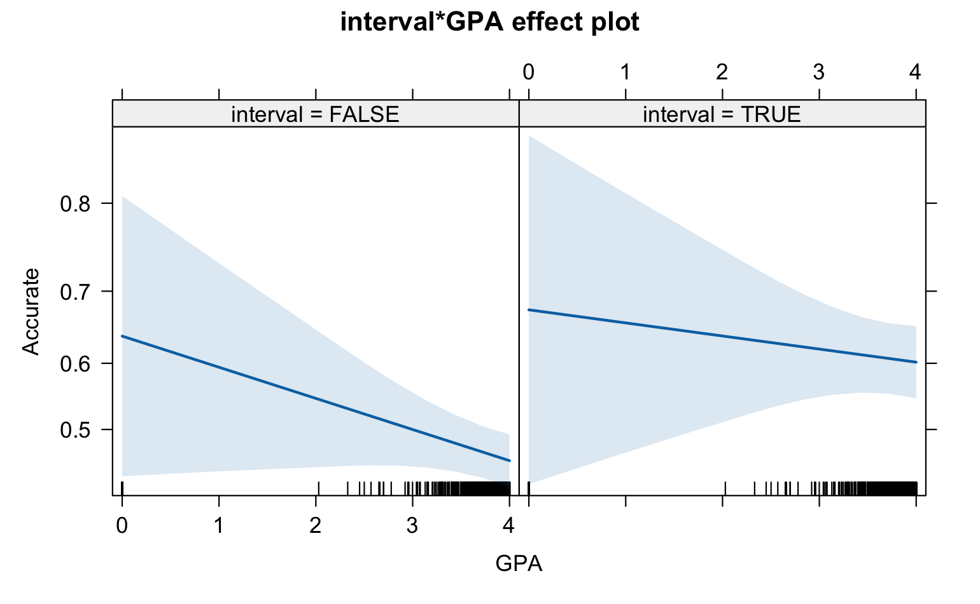
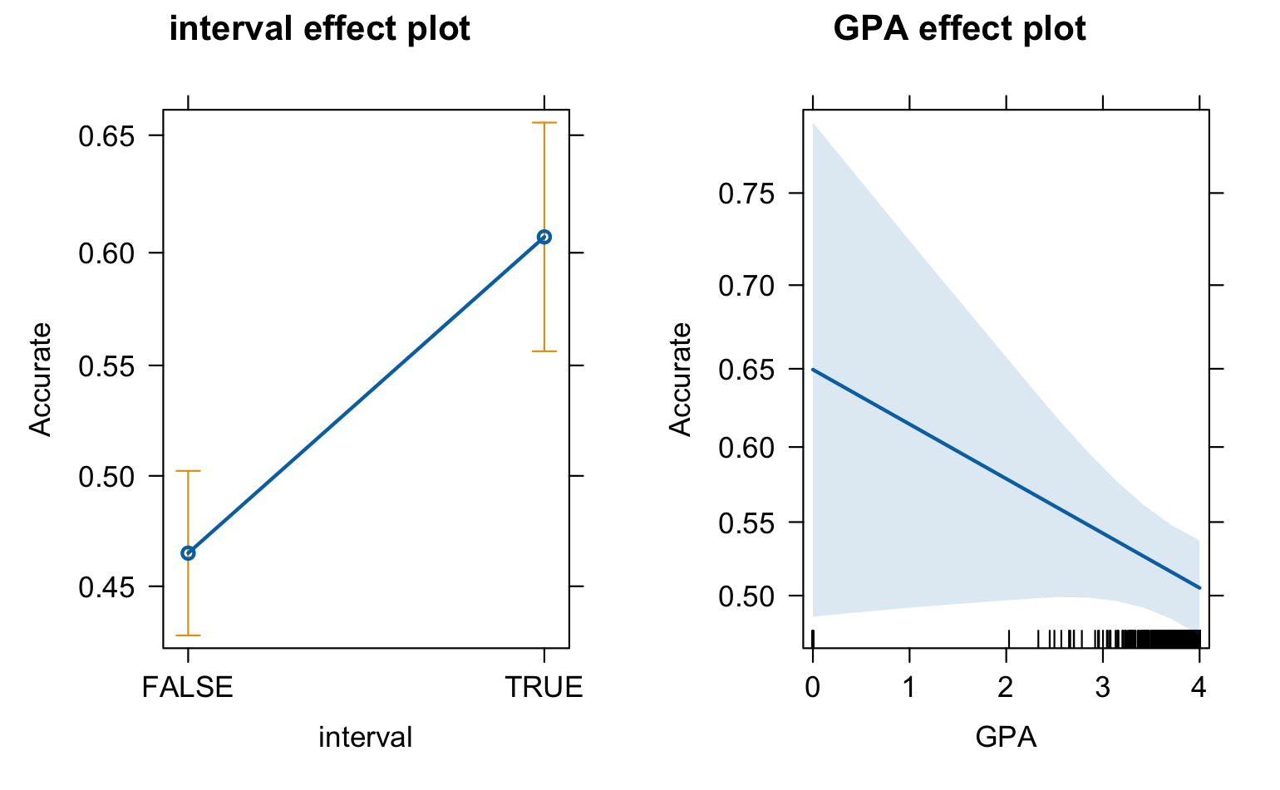
Analysis of Interval Using Logistic Regression
Logistic model considering interaction effect between interval and GPA
Displays changes in probability of an accurate self placement across different combinations of interval value and GPA value
Logistic model with Accuracy across interval and GPA
Left plot displays predicted probabilities if the AWPE score is in our interval
Right plot displays predicted probabilities
of accuracy based off GPA values

Slide 10
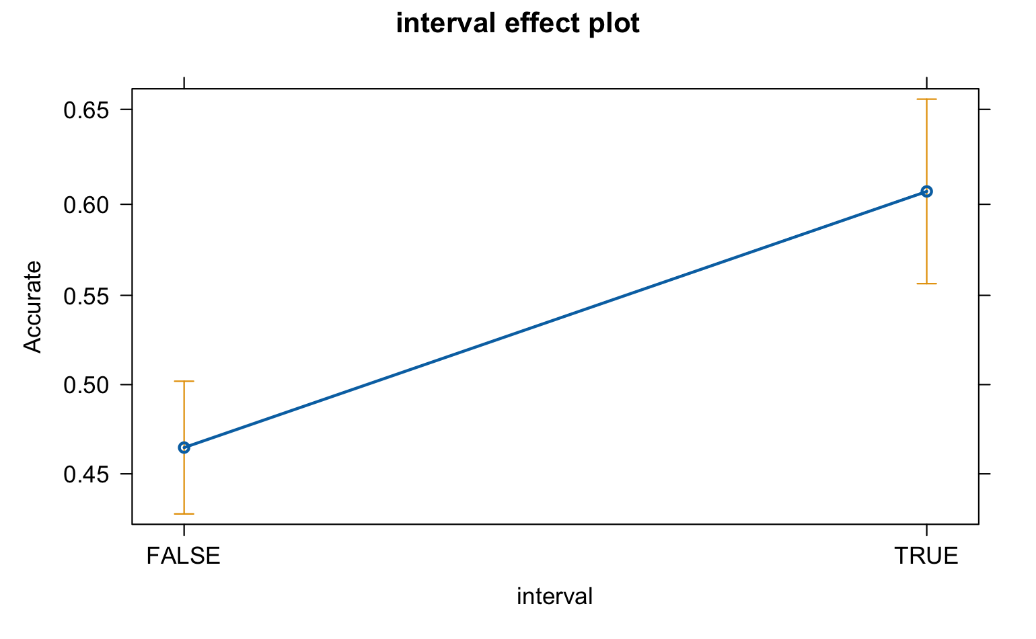
Analysis of Interval Using Logistic Regression
This plot was made from the logistic regression model of accuracy across interval
Shows us that accuracy is higher when we are in our interval than when we are not
From partial f tests (anovas) we saw that this reduced model was sufficient to represent our data

Slide 11
Main Conclusion
Students whose AWPE scores fell within the interval [41, 48], had aligned scores 61% of the time: significantly greater than those with scores outside the interval. Scoring within the interval significantly predicted aligned placement.
Notes:
In conclusion, self-placement scores offer insight into students' writing skills, especially for those with AWPE scores between 41 and 48. The strong correlation (p-value: 6.1e-06) shows 61% alignment in this range, significantly higher than outside it, making scoring within this interval a reliable predictor of aligned placement.

Slide 12
Limitations
Proportion in the Interval
The proportion of aligned self-placement scores within the interval [41, 48] is only 0.61.
A higher proportion would strengthen the reliability of our conclusions.
Data Sample Size
Increase sample size to avoid impact of missing values
Larger samples might reveal additional patterns that were not found in our analysis.
Imbalanced dataset
The majority of students placed themselves in class 3 and 2, with only few in 1, which results in an imbalanced dataset.
Thus our conclusions are somewhat limited
Notes:
Higher proportion like 0.8 or 0.9 can be more convincing
1067 samples, a few with missing values.

Slide 13
Thank you!

